Slide 1
Secured Data hiding in images using Stegonagraphy
Edunet Foundation(IBM) – AICTE Internship
Presented By
Student Name : HARSHINI.U
College Name : Rajalakshmi Engineering College, Thandalam,Chennai,Tamilnadu
Department : Bachelor of Engineering in Computer Science and Engineering (CSE)

Slide 2
OUTLINE
Problem Statement
Technology used
Wow factor
End users
Result
Conclusion
Git-hub Link
Future scope

Slide 3
Problem Statement
Problem Statement: Secured Data Hiding in Images Using Steganography
With increasing cyber threats, securing sensitive data during transmission is crucial. This project focuses on hiding confidential messages inside images using Least Significant Bit (LSB) steganography. It includes encryption (embedding the message) and decryption (extracting the hidden data). The system ensures data security while keeping the image visually unchanged. Implemented using OpenCV in Python, it provides an efficient and undetectable way to safeguard information.

Slide 4
Technology used
Libraries Used:
OpenCV (cv2) – For image processing.
OS (os) – To open the encrypted image.
String (string) – For character encoding.
Platforms Supported:
Windows – Uses os.system("start encryptedImage.jpg") to open the image.
Linux – Can be modified to use os.system("xdg-open encryptedImage.jpg").

Slide 5
Wow factors
Simple Pixel-Based Steganography 🎭
Hides each character of the message directly into the pixel values of the image without complex encryption.
Password-Protected Decryption 🔐
Ensures that only users with the correct passcode can extract the hidden message.
Diagonal Pixel Encoding 📏
Embeds the message in a diagonal pattern across the image to distribute data instead of modifying consecutive pixels.
Basic ASCII Character Mapping 🔄
Converts characters into their ASCII values for storage and retrieves them using a reverse mapping technique.

Slide 6
End users
Cybersecurity Professionals 🔐
Can use this method to securely exchange sensitive information without attracting attention.
Journalists & Whistleblowers 📰
Helps in hiding confidential messages within images to communicate discreetly in sensitive environments.
Government & Defense Agencies 🏛️
Useful for classified data transmission and covert communication without being detected.

Slide 7


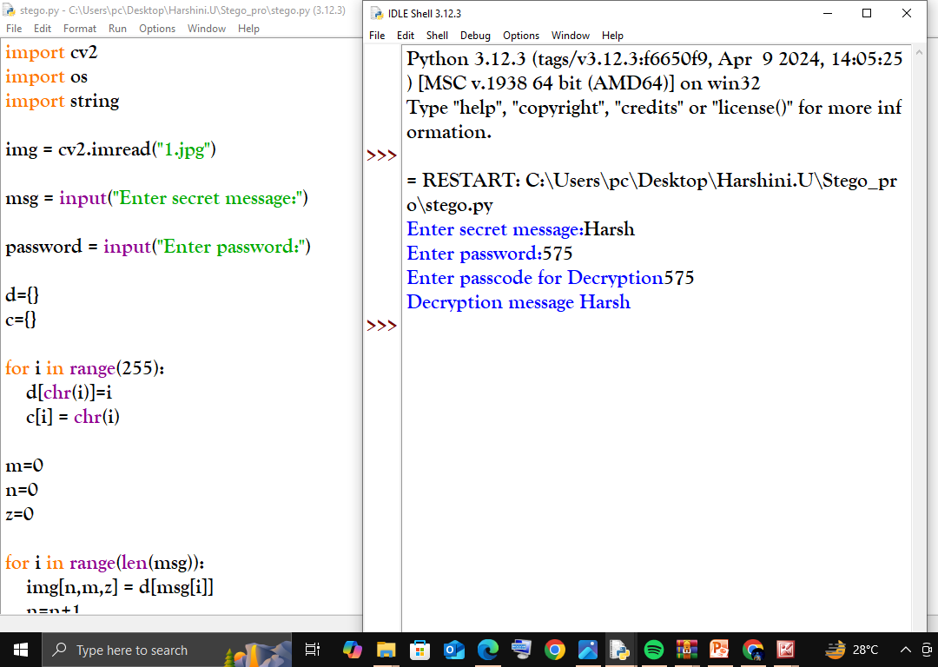
Results
Original image
Decrypted image
Python code

Slide 8
Conclusion
The project "Secured Data Hiding in Images Using Steganography" successfully implements a method for securely embedding and retrieving secret messages within images. By utilizing OpenCV, NumPy, and Tkinter, the system ensures efficient image processing while maintaining minimal visual distortion. The added password protection enhances security, making it difficult for unauthorized users to access hidden data.
This project is highly useful for secure communication, cybersecurity applications, and confidential data exchange. It provides a lightweight, fast, and effective approach to steganography, making it a valuable tool for both academic research and real-world security implementations.
Future improvements could include AES encryption before embedding, support for multiple file types, and enhanced steganography techniques for better security.

Slide 9
GitHub Link
https://github.com/HarshiniUdayakumar/AICTE-_cybersecurityintern.git

Slide 10
Future scope:
Advanced Encryption Techniques 🔐
Integrate AES or RSA encryption before embedding the message to enhance security.
Support for Multiple File Types 📂
Extend steganography to audio, video, and document files instead of limiting it to images.
Improved Steganography Algorithms 🖼️
Implement DCT (Discrete Cosine Transform) or DWT (Discrete Wavelet Transform)-based steganography for better security and reduced detection risk.

Slide 11
THANK YOU

